Slide 1
Forrelation: A Problem that Optimally Separates Quantum from Classical Computing
|0⟩
H
H
H
|0⟩
H
f
H
g
H
|0⟩
H
H
H
Scott Aaronson (MIT)
Andris Ambainis (U. of Latvia)

Slide 2
What’s the biggest advantage QC ever gives you for anything?
Factoring and Discrete Log:
quantum
classical
Of course, only conjectural.
But in the black-box model, we can actually prove stuff!
x
f
f(x)
“Quantum query to f”:
Often M=2

Slide 3

Let P be a promise problem about f—e.g., is f 1-to-1 or 2-to-1? Is f periodic or far from periodic?
Q(P) = Bounded-error quantum query complexity of P
R(P) = Bounded-error randomized query complexity of P
“Shor’s real result”:
Buhrman et al.’s Speedup Question (2001):
Is this the best possible? Could there be a property of N-bit strings that took only O(1) queries to test quantumly, but Ω(N) classically?

Slide 4
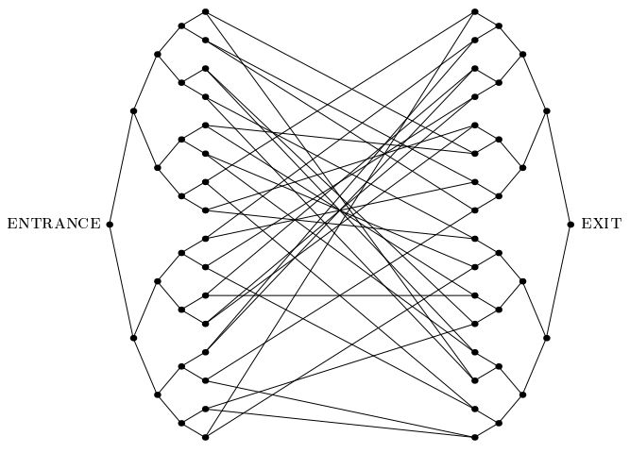
Known separations are “suboptimal”!
Simon’s Problem: Q=O(log N), R=Ω(√N)
Glued Trees (Childs et al. 2003): Q=O(polylog N), R=Ω(√N)
For total Boolean functions [BBCMW’98] and symmetric functions [A.-Ambainis 2013], only polynomial separations are possible

Slide 5
Our Main Results
1. Largest Known Quantum Speedup. A problem (Forrelation) with
For classical people: a lower bound on number of randomized queries needed to detect small pairwise covariances in real Gaussian variables x₁,…,x_{N}
Answers Buhrman et al.’s Speedup Question in the negative
2. Optimality of Speedup. For every partial Boolean function P, if Q(P)≤T then
For classical people: a randomized algorithm to approximate bounded, low-degree, “block-multilinear” polynomials with a sublinear number of queries

Slide 6
The Forrelation Problem
Given black-box access to two Boolean functions
Let
Decide whether Φ_{f,g}≥0.6 or |Φ_{f,g}|≤0.01, promised that one of these is the case
A. 2010: Introduced this problem, as a candidate for a black-box problem in BQP but not in PH
Showed that R(Forrelation)=Ω(N^{1/4}) and Q(Forrelation)=1

Slide 7
Example
f(0000)=-1 f(0001)=+1 f(0010)=+1 f(0011)=+1 f(0100)=-1 f(0101)=+1 f(0110)=+1 f(0111)=-1 f(1000)=+1 f(1001)=-1 f(1010)=+1 f(1011)=-1 f(1100)=+1 f(1101)=-1 f(1110)=-1 f(1111)=+1
g(0000)=+1 g(0001)=+1 g(0010)=-1 g(0011)=-1 g(0100)=+1 g(0101)=+1 g(0110)=-1 g(0111)=-1 g(1000)=+1 g(1001)=-1 g(1010)=-1 g(1011)=-1 g(1100)=+1 g(1101)=-1 g(1110)=-1 g(1111)=+1

Slide 8
Trivial Quantum Algorithm!
|0⟩
H
H
H
|0⟩
H
f
H
g
H
|0⟩
H
H
H
Probability of observing |0⟩^{⊗n}:
Can even reduce from 2 queries to 1

Slide 9
Proving the Randomized Lower Bound
Gaussian Distinguishing: We’re given real N(0,1) Gaussian variables x₁,…,x_{M}, and promised that either
The x_{i}’s are all independent, or
The x_{i}’s lie in a fixed low-dimensional subspace S≤R^{M}, which causes |Cov(x_{i},x_{j})|≤ε for all i,j
Problem: Decide which.
Gaussian Distinguishing ≤ Forrelation (rounding reduction):
Theorem:

Slide 10
Main Result: Any classical algorithm for Gaussian Distinguishing must query variables
(In Forrelation case, M=2N and ε=1/√N, so get )
Proof Idea: Treat each query as giving ⟨Ψ|v_{i}⟩, where |Ψ⟩ is Gaussian and v₁,…,v_{M} are unit “test vectors” such that |⟨v_{i}|v_{j}⟩|≤ε for all i,j
If the v_{i}’s were perfectly orthogonal, each query would return an independent N(0,1) Gaussian. As it is, the v_{i}’s are close to orthogonal
So, use Gram-Schmidt and Azuma’s Inequality to argue the first t query responses are close to independent Gaussians, w.h.p.—meaning the algorithm hasn’t yet learned much
v₁
v₂

Slide 11
Classical Simulation of k-Query Quantum Algorithms
Beals et al. 1998: Let A be a quantum algorithm that makes T queries to X=(x₁,…,x_{N}). Then p(X)=Pr[A accepts X] is a real polynomial in the x_{i}’s, of degree at most 2T
Our Addendum: There’s a degree-2T block-multilinear polynomial, q(X₁,…,X_{2T}), which equals p(X) whenever X₁=…=X_{2T}=X, and is bounded in [-1,1] for all Boolean X₁,…,X_{2T}
Reason: q(X₁,…,X_{2T}) is an inner product of two valid quantum states |ψ⟩ and |ϕ⟩, both obtained by varying A’s oracle across each of T queries
X₁
X₂
X₃
X₄

Slide 12
Theorem: Let q(X₁,…,X_{k}) be any degree-k block-multilinear polynomial that’s bounded in [-1,1] (where each X_{i}∈{0,1}^{N})
Then there’s a randomized algorithm that approximates q to within ±ε, with high probability, by querying only
variables
Proof Idea: Repeatedly identify influential variables and “split” them. Produces exp(k)⋅O(N) new variables, which is linear for constant k
Then just pick a set S of variables at random, query them, and estimate q by summing only monomials over S

Slide 13
k-Fold Forrelation
Given k Boolean functions f₁,…,f_{k}:{0,1}^{n}→{1,-1}, estimate
Once again, there’s a trivial k-query quantum algorithm! (Can be improved to k/2 queries)
|0⟩
H
H
H
Bonus Theorem: k-fold Forrelation is BQP-complete for k=poly(n), if f₁,…,f_{k} are described by circuits—giving a second sense in which it “captures the full power of QC”
|0⟩
H
f₁
H
f_{k}
H
|0⟩
H
H
H
Our Conjecture: k-fold Forrelation requires Ω(N^{1-1/k}) randomized queries—achieving the optimal gap for all k

Slide 14
Open Problems
Prove the classical lower bound for k-fold Forrelation
More broadly: Is there any partial Boolean function P such that Q(P)=polylog(N) while R(P)>>√N?
Non-black-box applications of Forrelation?
Generalize our O(N^{1-1/k})-query estimation algorithm from block-multilinear to arbitrary polynomials We can do this in the special case k=2, using DFKO
What’s the best quantum/classical query complexity separation for sampling problems? We show: Fourier Sampling has

